Slide 1
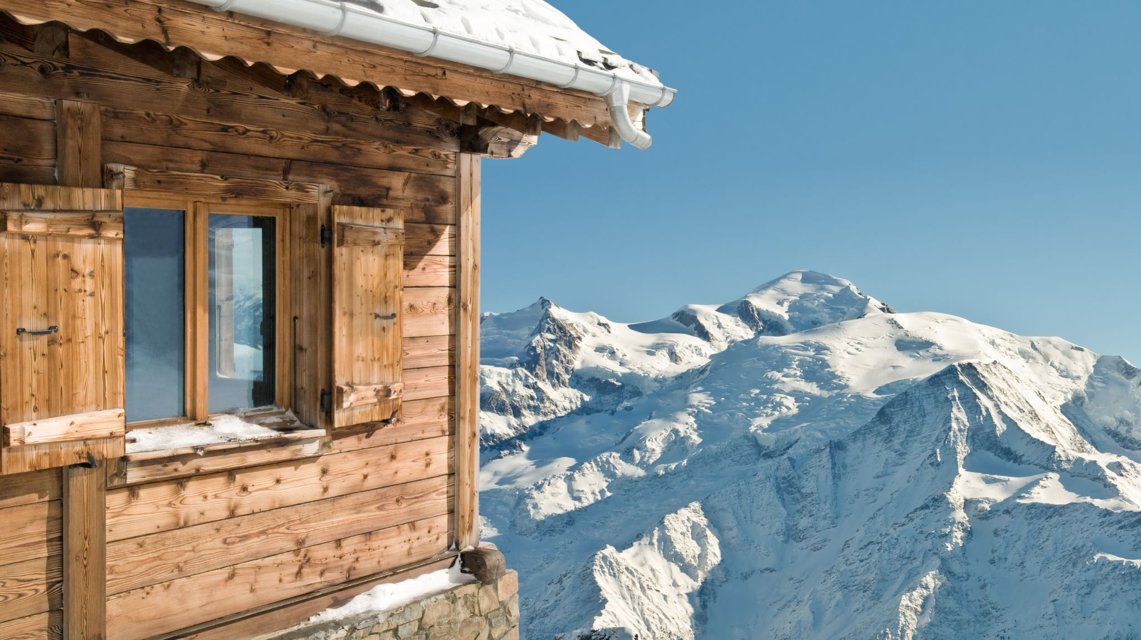
Big Mountain Resort Pricing Analysis
Sri Hari Chalagalla

Slide 2

Problem Statement
How do we increase revenue and stay competitive for the upcoming season?
Current adult weekend price is $81, placing it at high end compared to competitors.
The challenge is to justify the pricing structure while enhancing competitiveness and customer experience.

Slide 3
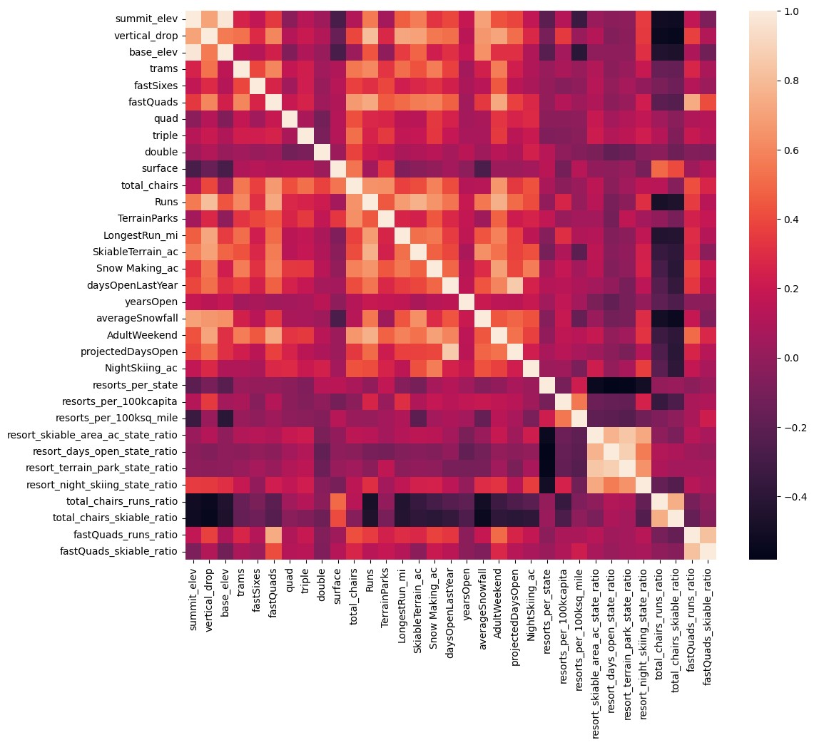
Key Findings
Four features have a strong positive correlation with Adult weekend pricing
fastQuads
SnowMaking_Ac
Runs
Nigh skiing ration
Random Forest Model Price:$95.87
Resort has significant enough facilities to justify this cost
During the analysis vertical drop is found to be significant feature

Slide 4
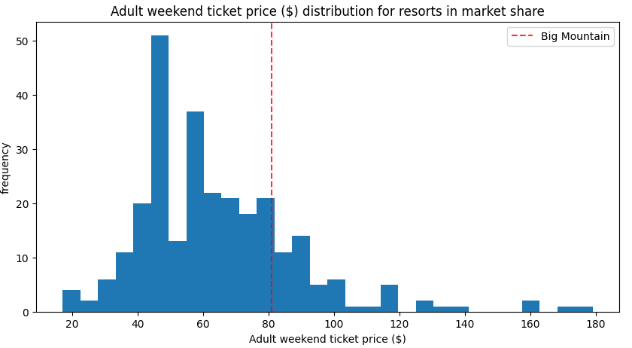
Model and Analysis
Big Mountain Resort ranks in the top quarter for seven of the eight most important features offered by all the resorts.
Vertical drop
Snow making area
Total number of chairs
fastQuads
Runs
Longest run
Skiable terrain area

Slide 5
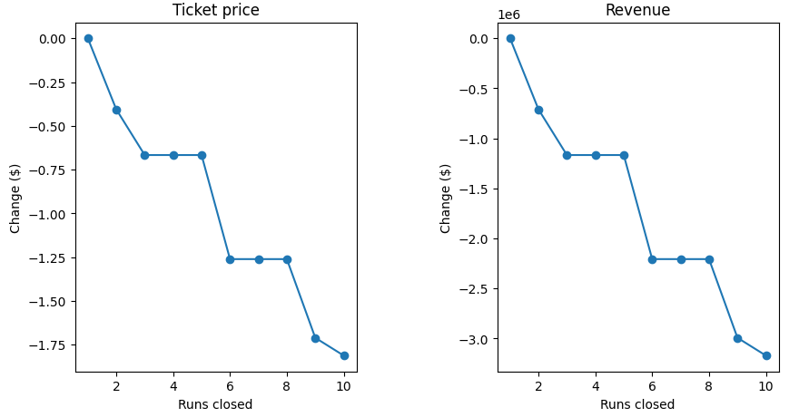
Recommendation
Key Recommendations:
Increase Ticket Price to $85.5
Have 4-5 runs closed each day to save on operation costs
Increase vertical drop by lowering a run 150ft, install one additional chair lift, add one additional run and increase acres of snow cover by two.
The model predicts that this could justify $2 increase in ticket price, which would increase revenue by $3.47 million

Slide 6
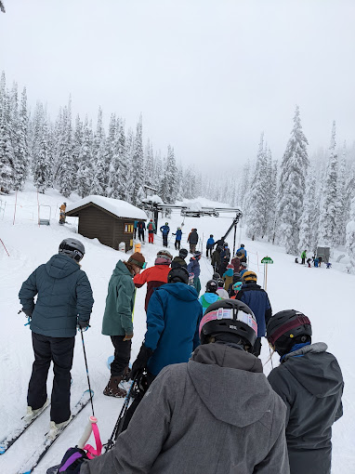

Summary and conclusion
Key Takeaways:
Big Mountain Resort has strong market potential and quality offerings.
A modest price increase, supported by enhancements is justified and could significantly boost revenue.

Slide 7

Thank You!

